Slide 1

Capstone Project Review
By:- Joel Binu Philip
Project Name : Service Management System
A Comprehensive Microservices Platform for End-to-End Home Service Lifecycle Management.

Slide 2
Problem Statement
In today’s on-demand home service industry, service providers face significant challenges due to fragmented workflows, manual coordination, and lack of real-time visibility across the service lifecycle. Traditional service management approaches rely heavily on disconnected communication channels, and isolated data storage, resulting in delayed service delivery, poor customer experience, and limited operational insights.
Target Users:
Customers: For booking and tracking home services.
Technicians: For managing assigned tasks and workload.
Service Managers: For technician approval and task assignment.
Admins: For system-wide configuration and reporting.
Market Need: A scalable, secure, and automated solution to bridge the gap between service providers and end-users.

Slide 3
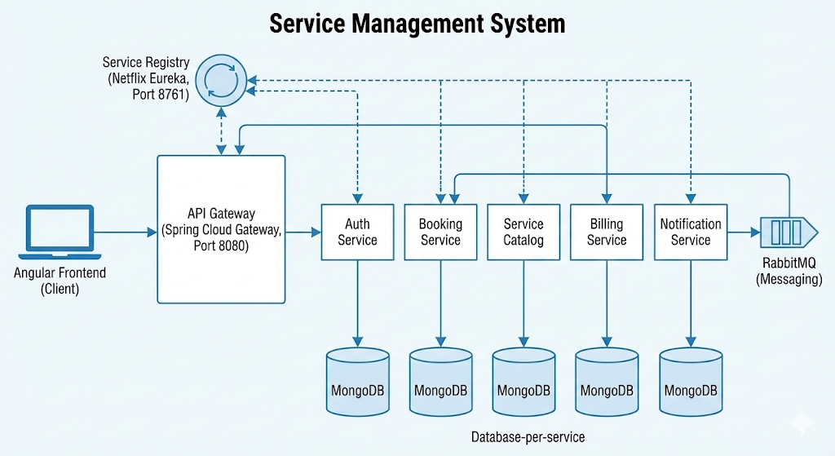
High Level Architecture Diagram

Slide 4
High-Level Architecture:
Frontend: Built with Angular :-
API Gateway: Spring Cloud Gateway serving as the single entry point (Port 8080).
Service Registry: Netflix Eureka for service discovery (Port 8761).
Microservices :-
Auth Service: Identity management and RBAC.
Booking Service: Core service lifecycle and dashboarding.
Service Catalog: Management of service categories and items.
Billing Service: Invoice generation and revenue tracking.
Notification Service: Real-time alerts via RabbitMQ.
Databases: Distributed MongoDB instances for each service.
Messaging: RabbitMQ for asynchronous event-driven communication.

Slide 5
Key Features
Customer: Service request creation, real-time status tracking (Pending to Completed), and rating/feedback system.
Technician: Professional profile application, workload status management (Toggle Availability), and OTP-based service completion.
Manager: Multi-stage technician approval workflow, smart technician assignment, and reassignment capabilities.
Admin: Dynamic catalog management (categories/services),and comprehensive revenue/performance reporting.

Slide 6
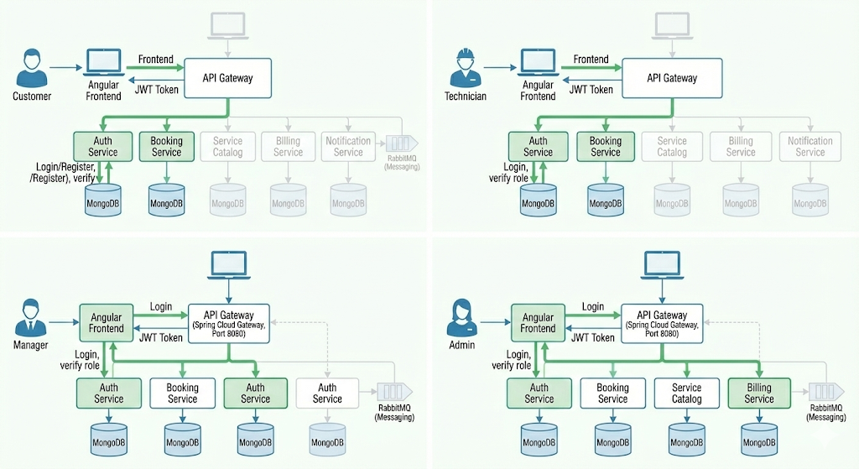
Role-Based Authentication & Service Access Flow

Slide 7
Technology Stack
Frontend: Angular (with RxJS and Bootstrap).
Backend: Java 17, Spring Boot, Spring Cloud (2023.0.0).
Microservices: Spring Cloud Gateway, Eureka Server, OpenFeign, and Resilience4j.
Database: MongoDB.
Messaging: RabbitMQ.
Security: JWT (JSON Web Tokens), Spring Security, and BCrypt password encoding.
Testing: JUnit 5, Mockito, and MockMvc.

Slide 8
Technical Highlights
Event-Driven Communication: Asynchronous notification delivery using RabbitMQ to decouple services.
Security & Compliance: Rate limiting on login, automated account locking after failed attempts, and full audit logs for sensitive actions.
Robust Error Handling: Global exception handling with consistent API response wrappers across all microservices.
Data Integrity: Transactional service layers and scheduled cleanup of expired tokens and logs.
Inter-service Reliability: OpenFeign clients with circuit breakers (Resilience4j) and fallback mechanisms

Slide 9
Feature | Business Rule (The "Why")
Technician Approval | Quality Control. Random people cannot just sign up and enter customers' homes.
OTP Completion | Fraud Prevention. Prevents technicians from marking a job "Done" without actually visiting the house.
Role Guarding | Security. A Technician cannot see the Admin panel; a Customer cannot assign jobs.
Email Verification | Identity Assurance. Ensures the user is reachable for invoices/notifications.
State Machine | Process Integrity. You can't "Complete" a job before you "Start" it.

Slide 10
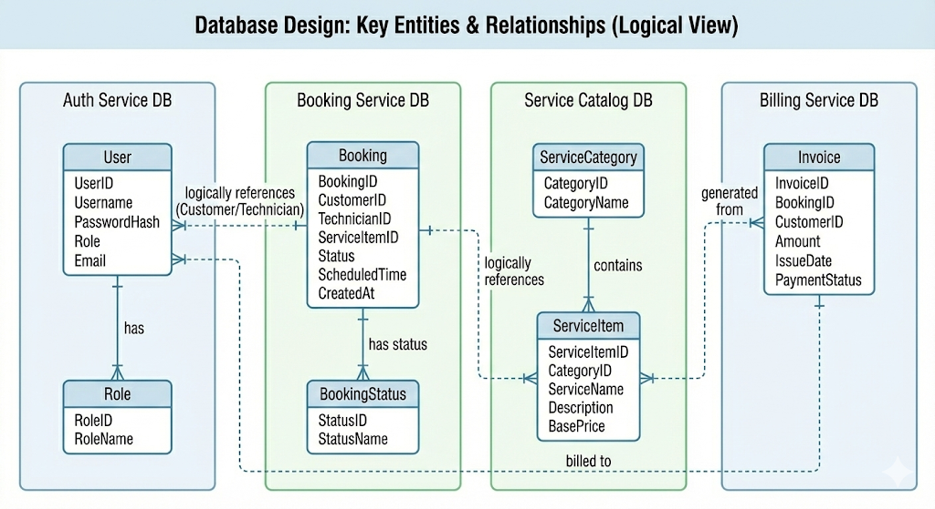

Slide 11
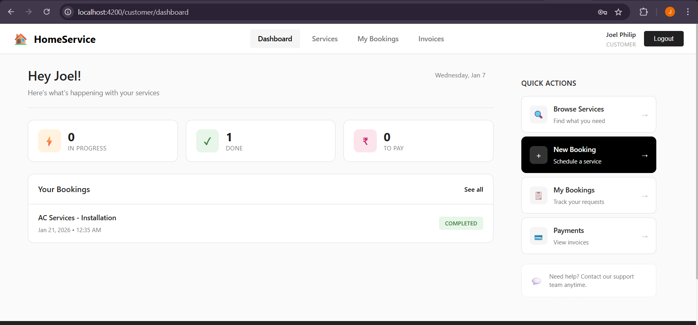
Customer Dashboard

Slide 12
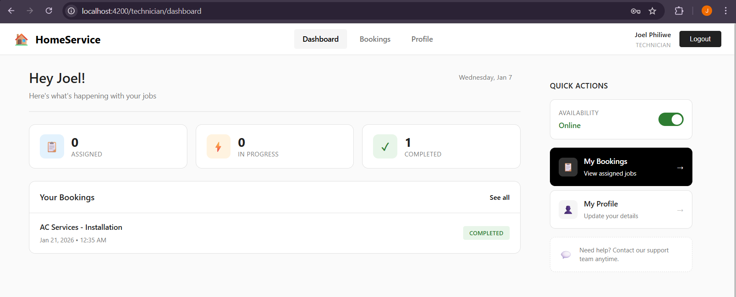
Technician Dashboard

Slide 13
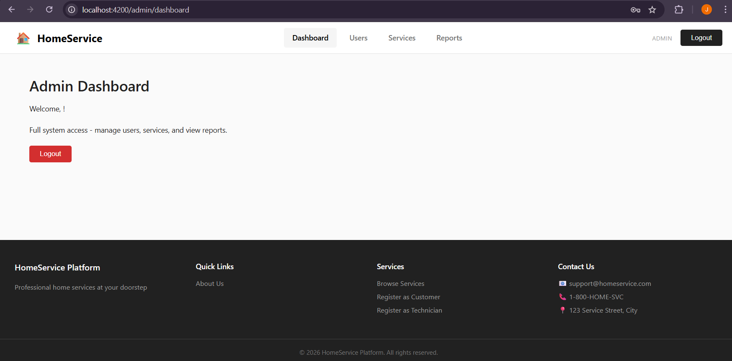
Admin Dashboard

Slide 14
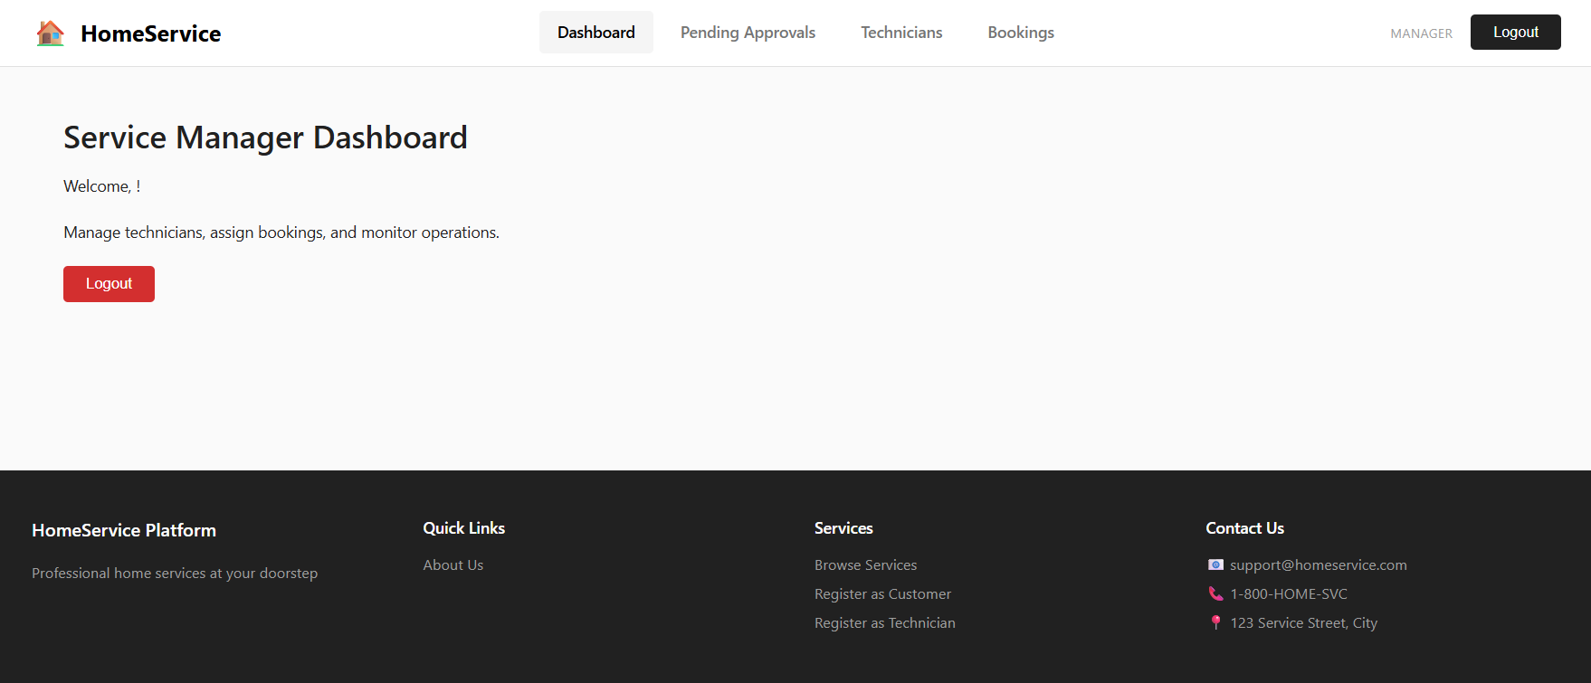
Service Manager Dashboard

Slide 15
Testing & Quality
Unit & Integration Testing: Extensive test coverage using MockMvc for controllers and Mockito for service-layer isolation.
Security Testing: Use of @WithMockUser to validate role-based access constraints (e.g., ensuring technicians cannot assign tasks).
Validation: Strict input validation using JSR-303 annotations (@NotBlank, @Pattern, @Size)

Slide 16
DevOps & Infrastructure
Docker: Containerization platform.
Docker Compose: Tool for defining running multi-container applications locally.
Jenkins: For Continuous Integration and Deployment (CI/CD) pipelines.
SonarQube: For continuous code quality inspection.

Slide 17
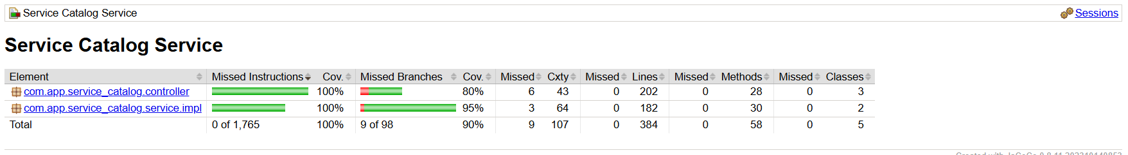
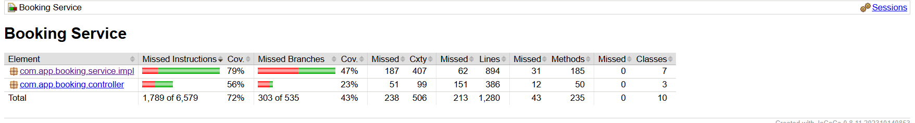
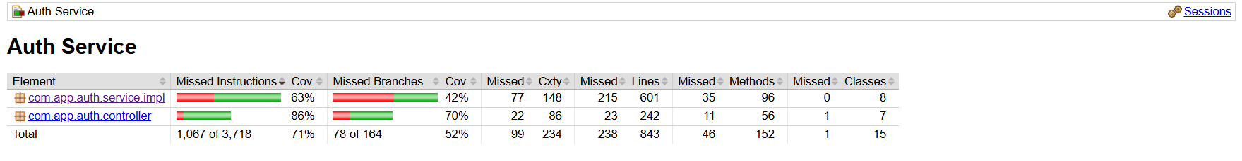
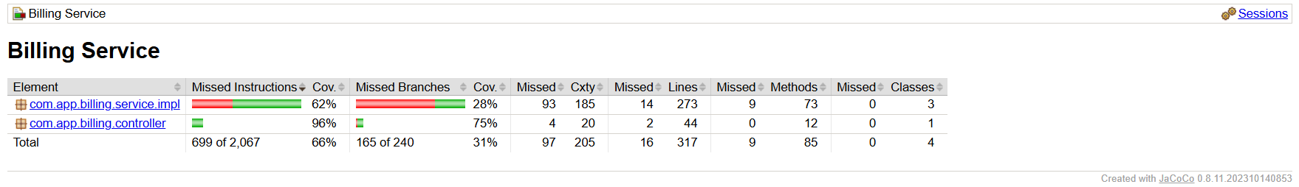
JaCoCo Report

Slide 18
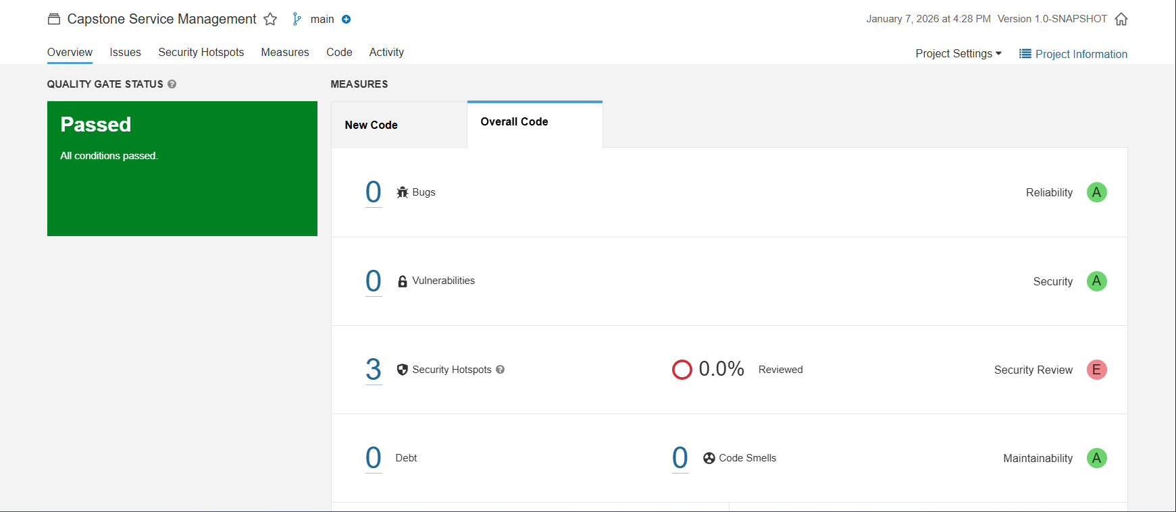
SonarQube Analysis

Slide 19
Future Enhancements
Scalability: Implementation of Kubernetes (K8s) for auto-scaling service instances based on load.
Features: Integration of a real-time chat service for Customers and Technicians.
Payment Gateway: Integration of external payment providers (e.g., Stripe/Razorpay) instead of just internal status updates.
Mobile App: Developing a Flutter or React Native mobile client for on-the-go service management.

